Slide 1
Welcome!
We are so glad you are here.
Transforming Lives and Communities Through the Power of Dance

Slide 2
We thank our sponsors and honor the Gabri Award Recipients
Nike and Renae Williams Niles
Transforming Lives and Communities Through the Power of Dance

Slide 3
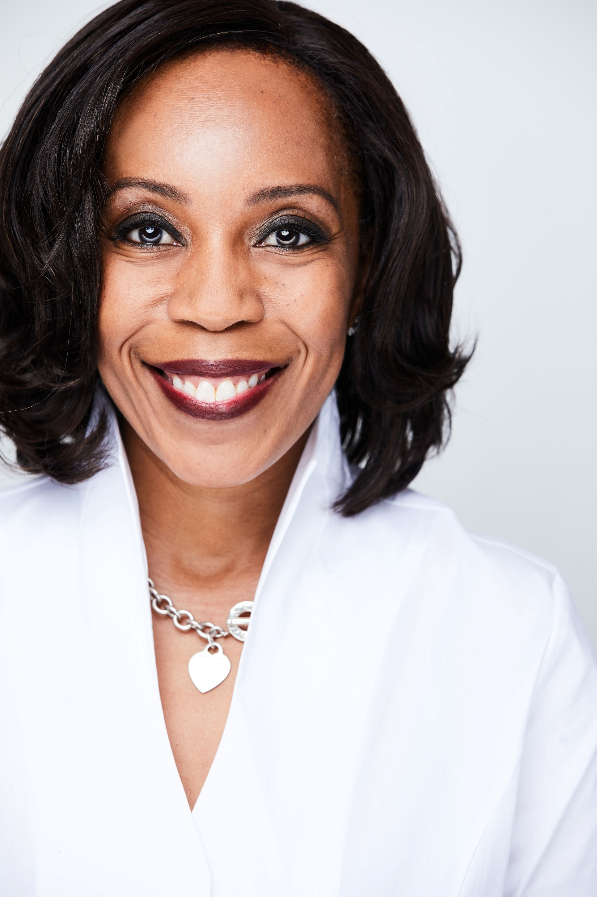
Congratulations!
Transforming Lives and Communities Through the Power of Dance

Slide 7
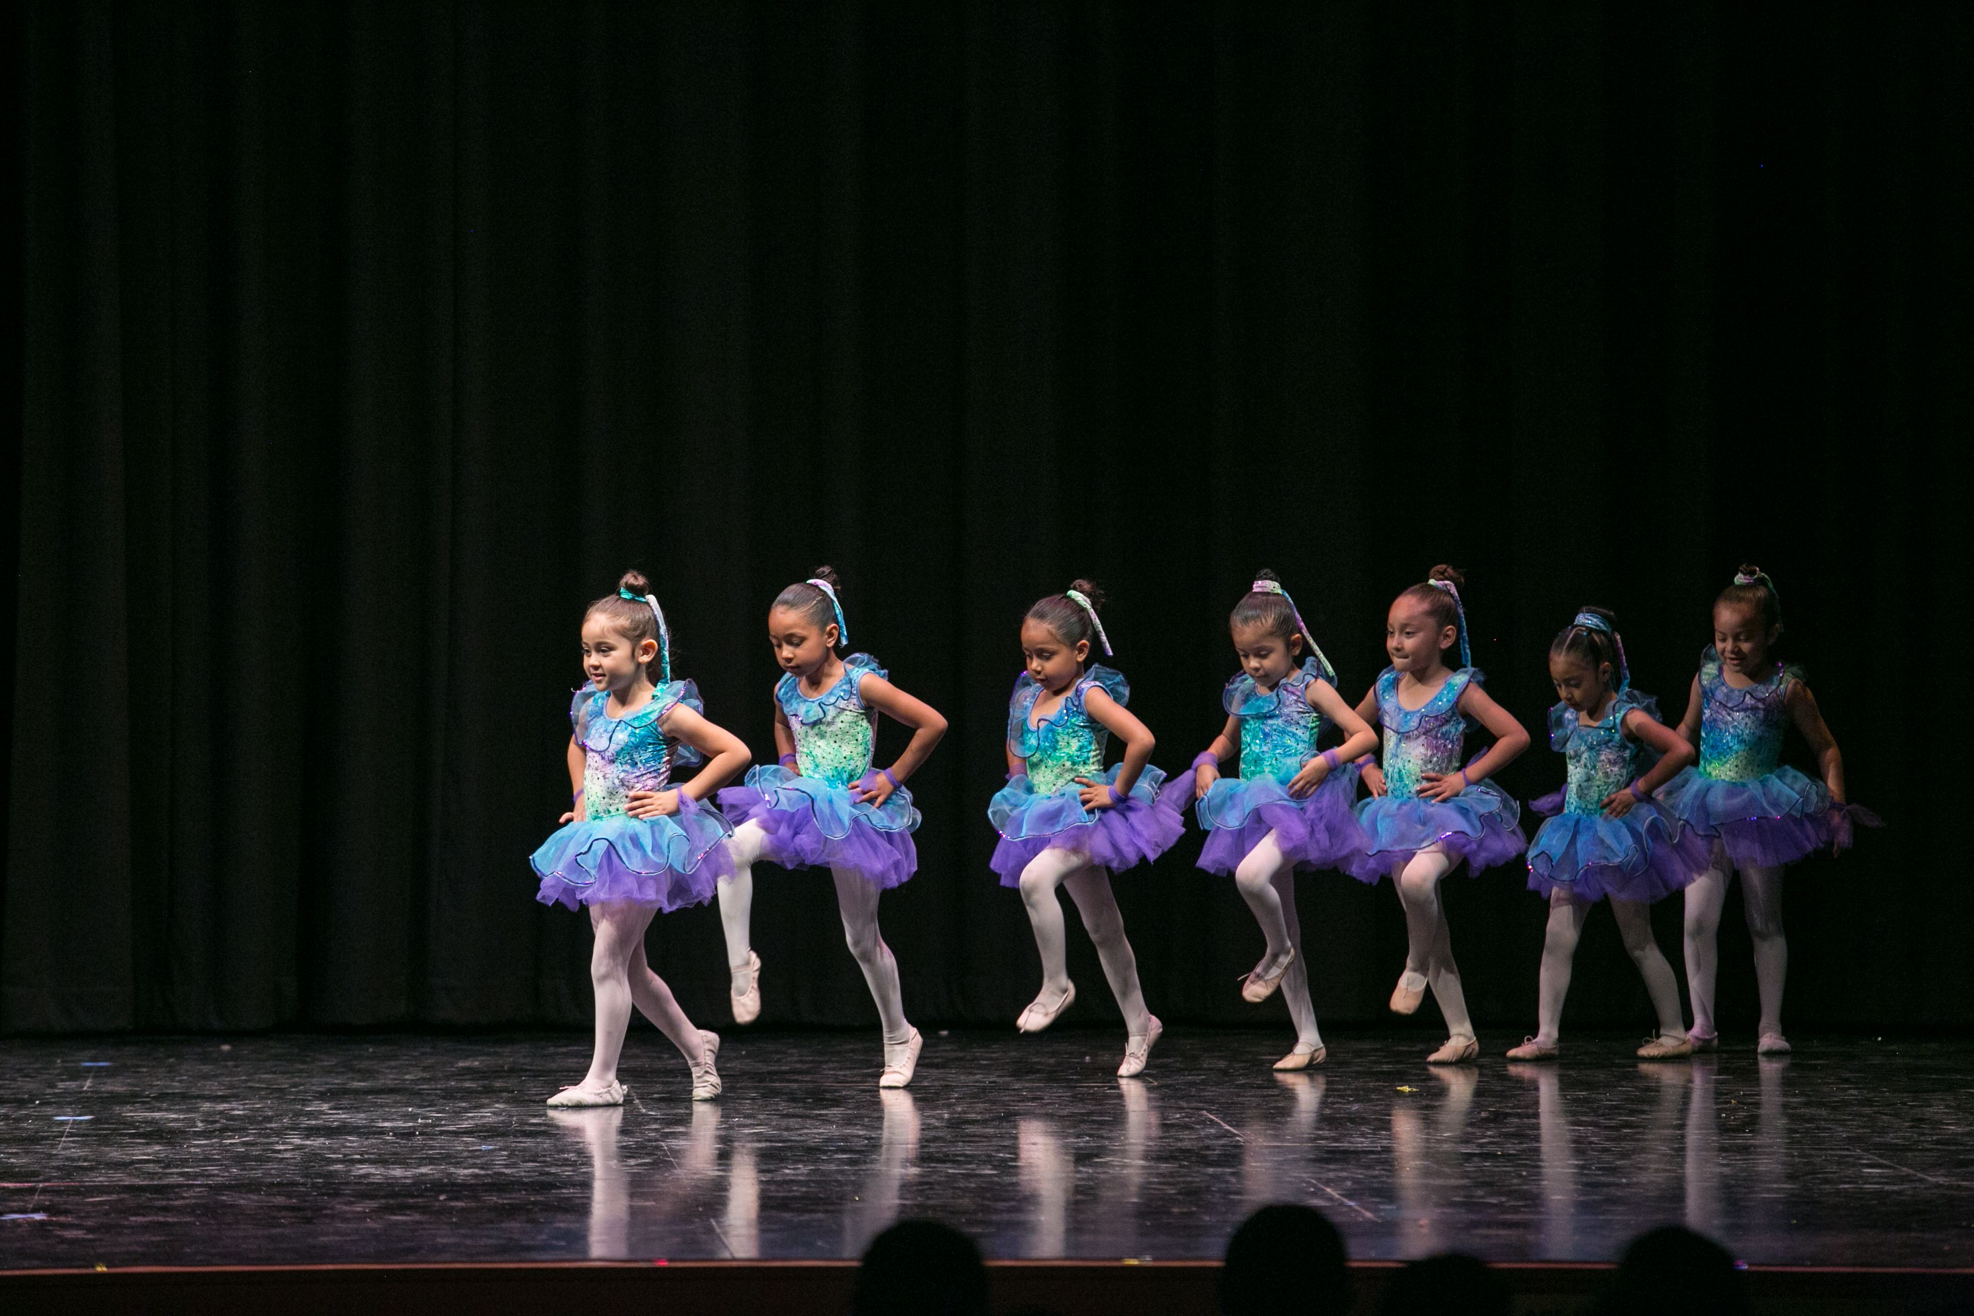
Thank you!

Slide 8
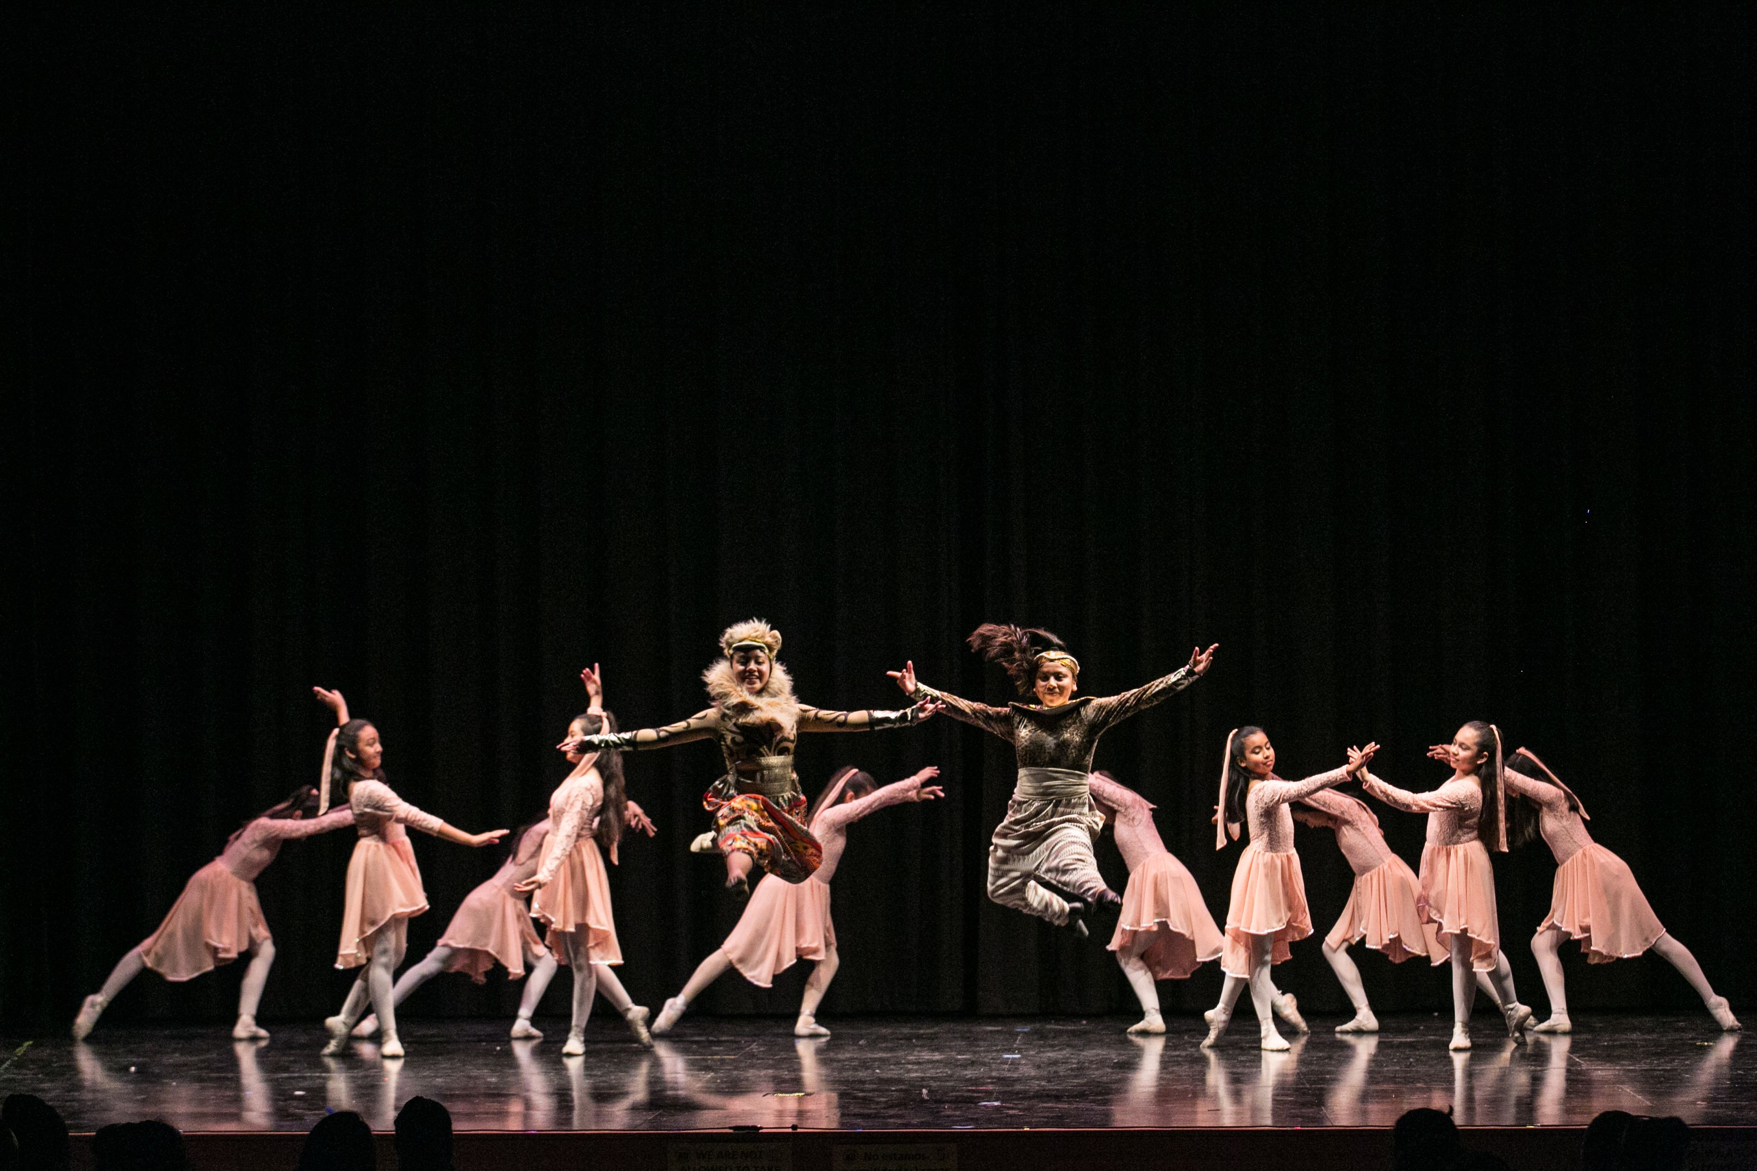
Thank you!

Slide 9
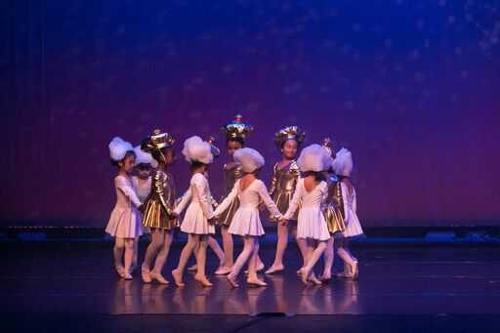
Thank you!

Slide 10
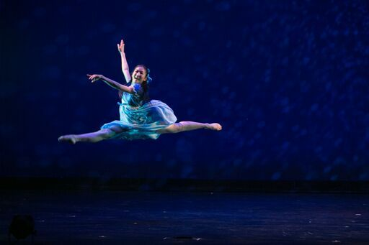
“To watch us dance is to hear our hearts speak” Thank you to our students and their teachers who dance from their hearts.
Jane Jelenko

Slide 11
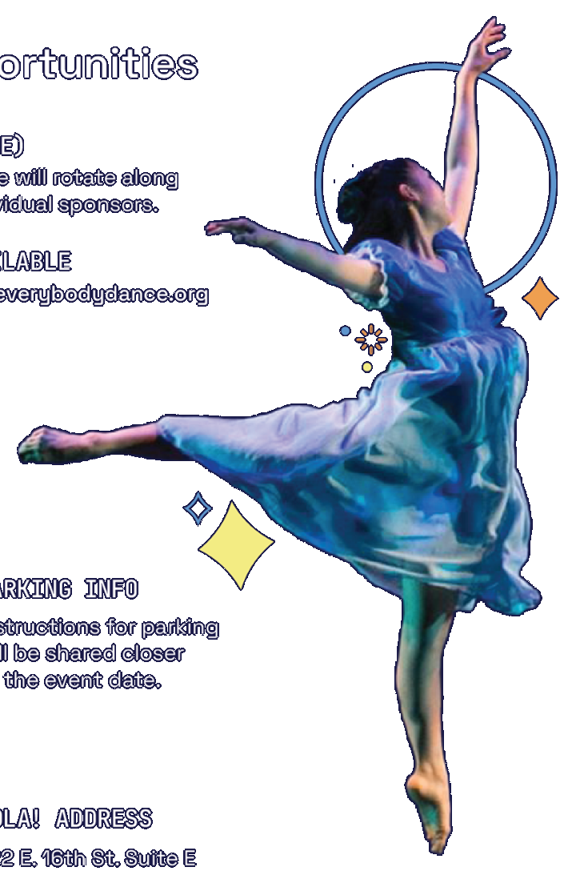
“The joy of dancing has a way of aligning body, heart, and mind to create harmony within ourselves that affects ourselves and those around us. I am proud to celebrate EDLA! and our teachers, students, and families who encourage them”. Charlene Achki Repko

Slide 12
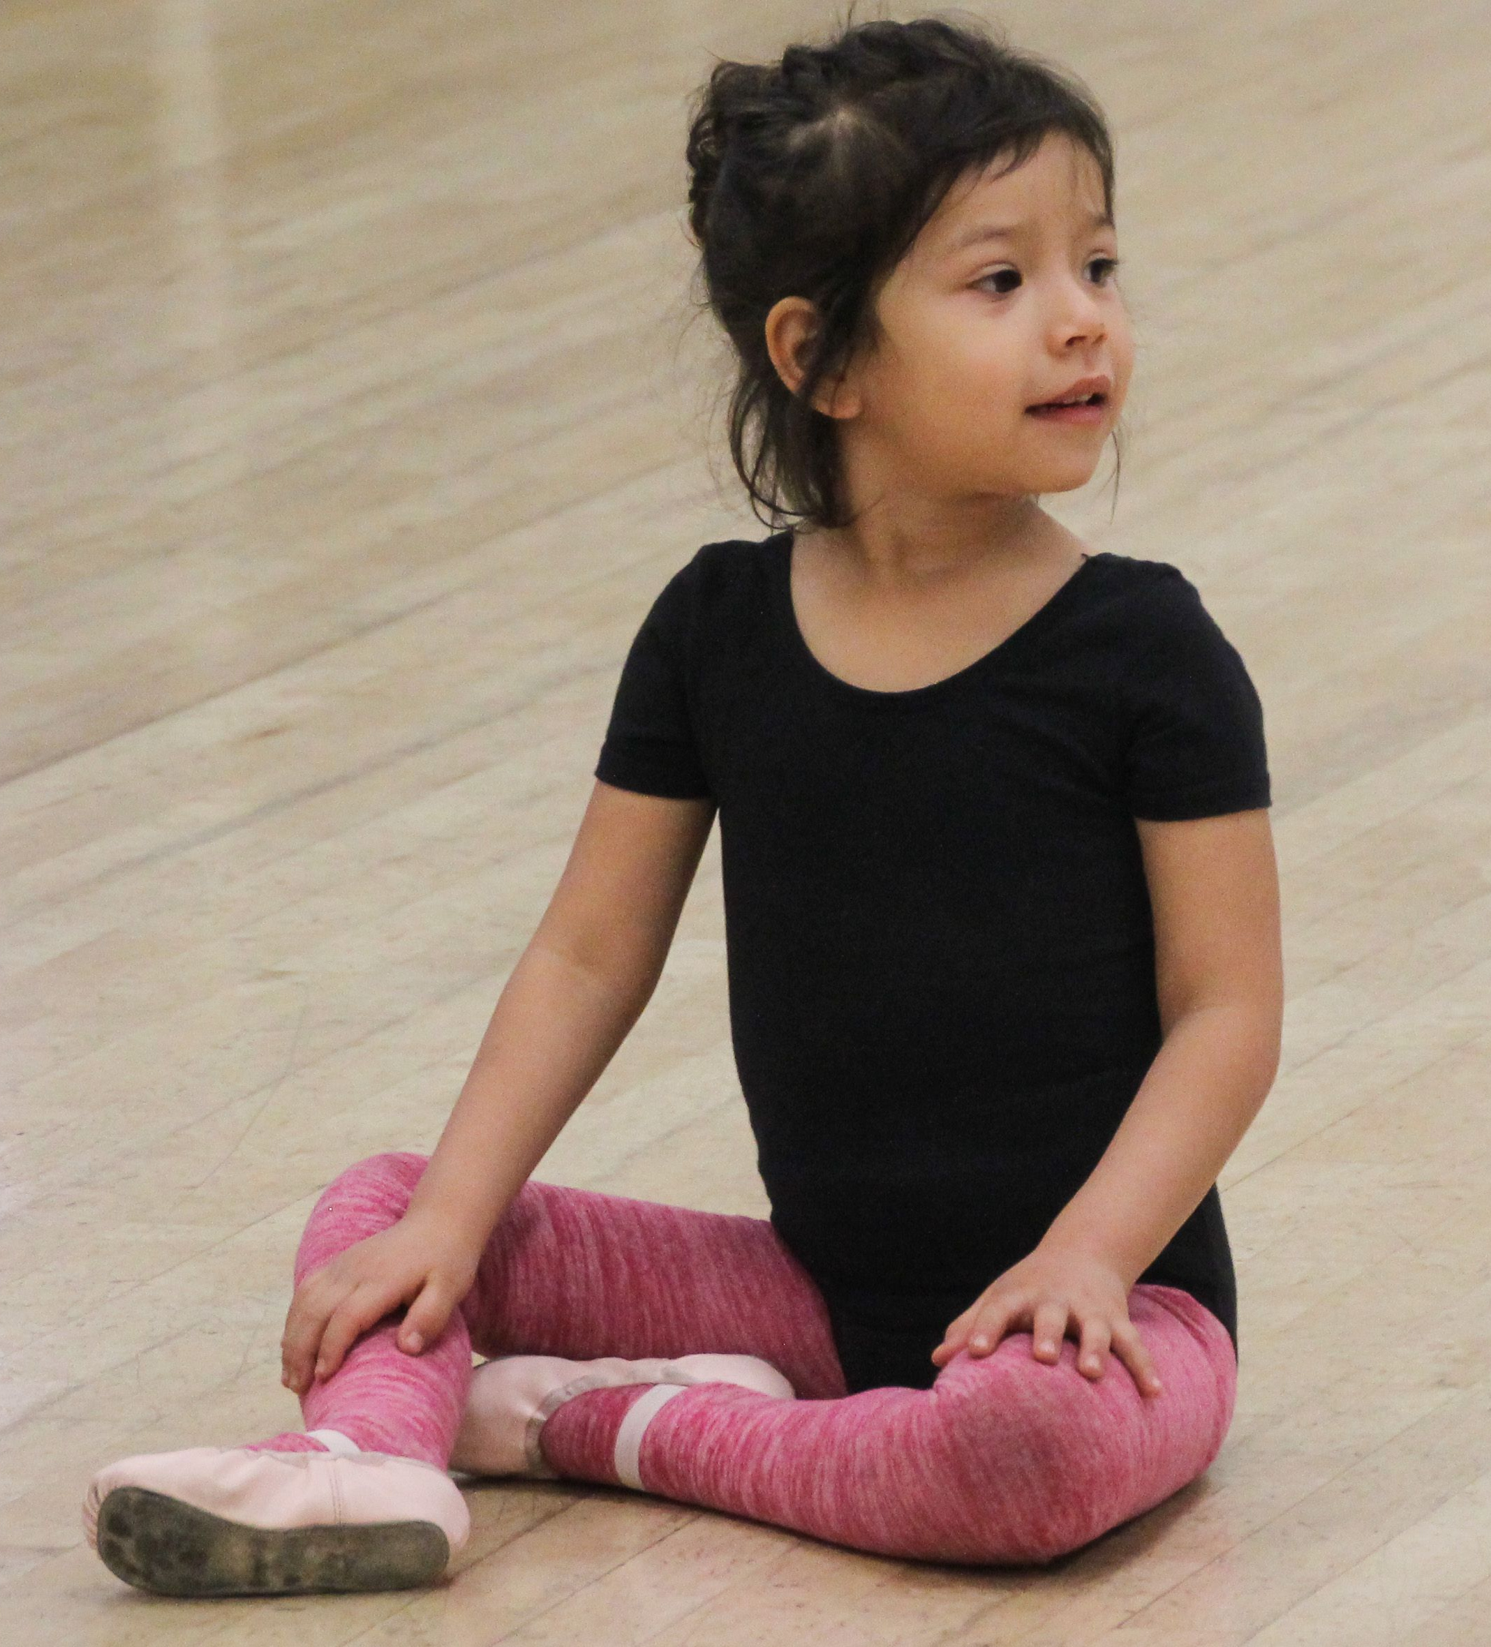
We celebrate our EDLA! family, our honorees, and all our supporters. Thank you!
Leah and Sam Fischer

Slide 13
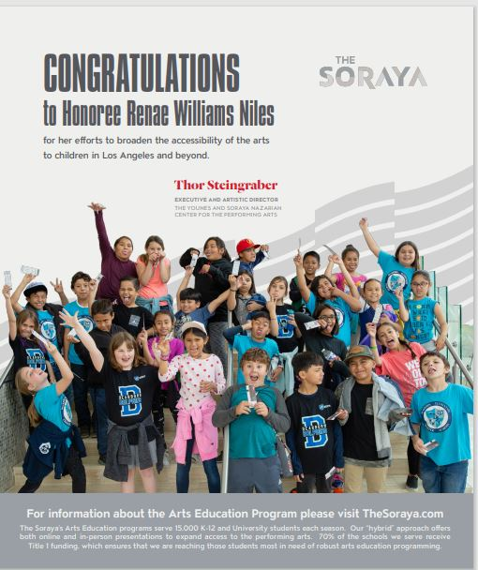

Slide 14
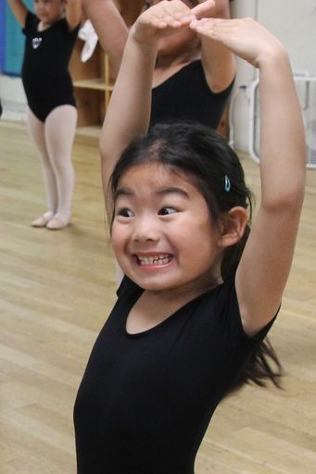
Thank you to our longtime supporters,
Lynne and Jimmy DeWitt Family Foundation!
Your kindness and commitment makes our hearts sing!

Slide 15
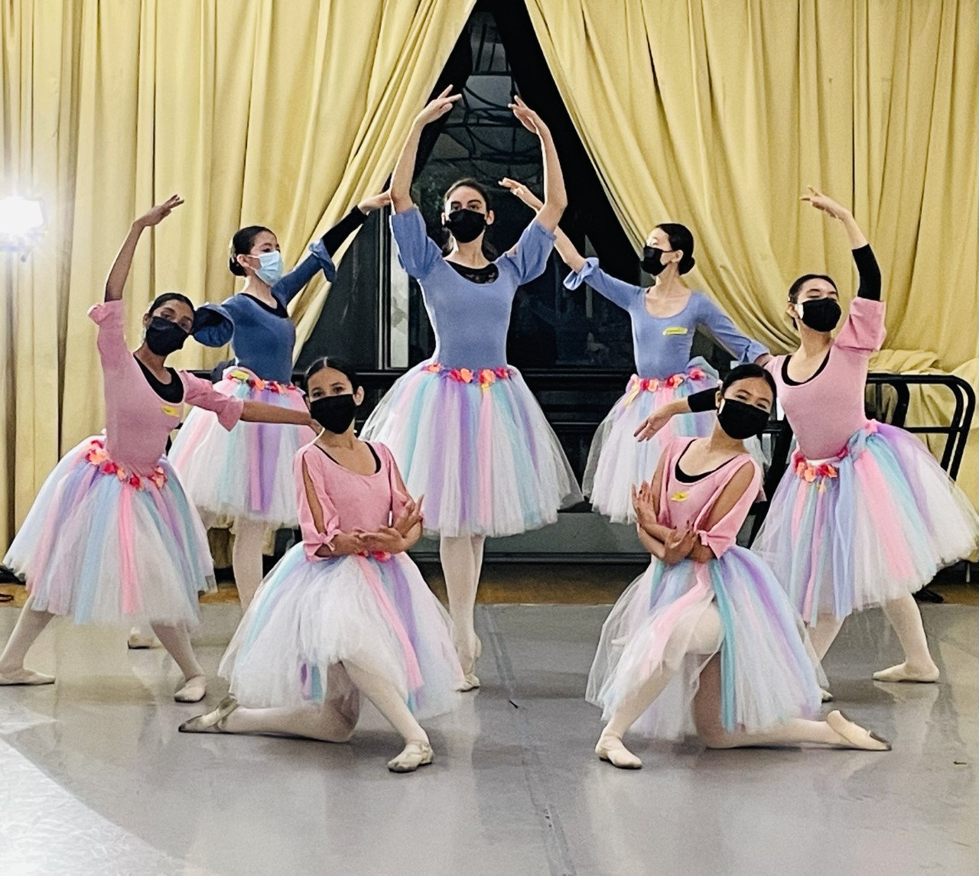
“I can do anything when I am in a tutu.” Misty Copeland
Bravo! Everybody Dance LA! Performers and Congratulations to our Gabri Award Honorees, Nike and Renae Williams Niles!
Kathleen McCaffrey

